Slide 1
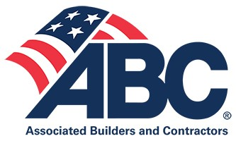
Coping with New Laws and Labor Tactics in Maryland
August 3, 2023

Slide 2
MAURY BASKIN
Construction Group Chair
Littler Mendelson, P.C.
ABC General Counsel
mbaskin@littler.com

Slide 3
State “wage theft” and “wage fraud” laws pose serious threats for contractors – the union connection
Union organizing and pressure tactics on the rise
Big changes happening in federal labor regulations
What you should be doing now to deal with these threats

Slide 4

Maryland’s Wage Theft Law – Already in Effect
MD law imposes triple damages and joint liability on general contractors if their subs fail to pay wages owed (MD L&E Code 3-507.2)
Part of a national trend targeting the construction industry for wage “theft” on both private and public projects
Multiple single-plaintiff and collective wage and hour actions have been filed against construction firms, with sizable potential damages and litigation costs
Criminal penalties have been imposed around the country

Slide 5
Misclassification of Employees as “1099” Independent Contractors
Maryland’s “workplace fraud” law presumes that anyone performing services for pay is an “employee,” not an “independent contractor.”
To overcome the presumption, the employer must show the worker meets the badly-named “ABC” test for independent contractors
Higher tier contractors may be responsible for misclassifications as “joint employers”
“Safe harbor” for contracts with responsible “business entities” (MD Code 3-903.1)

Slide 6
Wage Theft Compliance Tips for Maryland Employers
What Should Contractors Do Now?
Self-audit all 1099s –they are often misclassified
Review payment procedures (your own and your subcontractor’s) to limit
Ensure that your paystubs are compliant with the new laws; make sure to have safe harbor contract in place
Consider indemnification clauses, arbitration agreements with class action waivers, EPLI
If you’re a general contractor, create proper oversight procedures to ensure all subcontractors are appropriately paying their employees
Recognize the tension between being too “hands on” with subs leading to a joint employer finding and being too “hands off” leading to lax oversight and more risks
Recognize the union connection – wage violations give unions leverage over you

Slide 7
Expansion of prevailing wage and apprenticeship mandates to private work
Climate Solutions Now Act (2022) – MD utilities contractors now must pay prevailing wage and employ registered apprentices and health insurance
Inflation Reduction Act (2022) (federal) – clean energy tax credits conditioned on federal prevailing wage and mandatory apprenticeship

Slide 8

Union Organizing on the Rise
The Trump years saw union organizing fall to lowest levels since WWII
Construction was once 85% unionized; now it is at 13% nationally (10% in MD)
But the unions are making a comeback – with major help from the Biden Administration
The Administration’s Union Task Force
The recent surge in union elections; picketing; bannering; salting

Slide 9
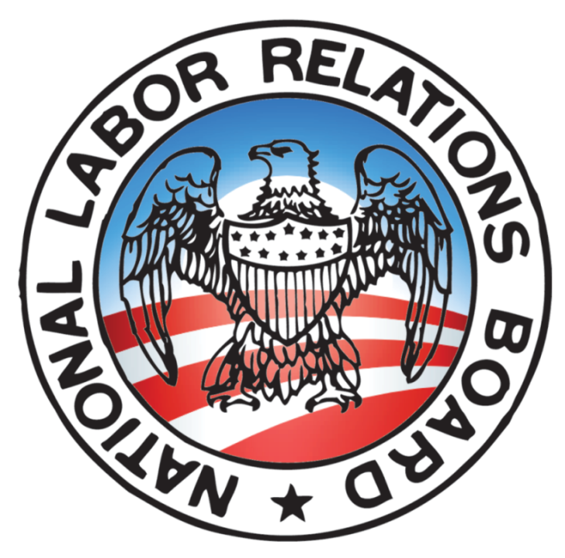
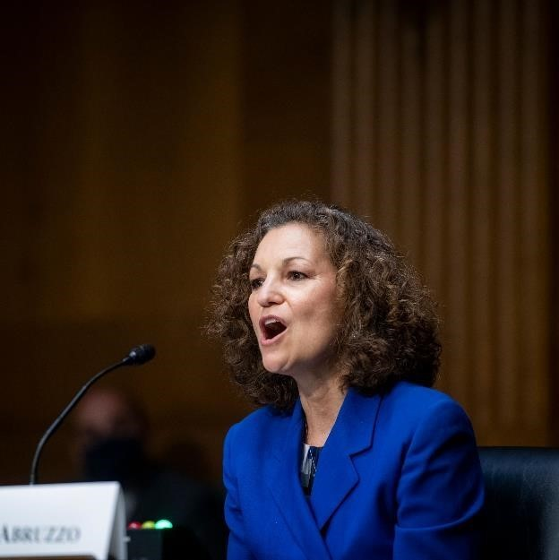
Change Is Happening At The NLRB
3-1 Pro-Labor Majority
A hyper-aggressive, pro-union General Counsel
Many basic ground rules have changed and more are coming (yesterday’s Stericycle ruling declared war on employee handbooks
More pro-union election rulings (Amazon, Starbucks)
Overturning longstanding policies that protected management
The assault on employer free speech rights

Slide 10
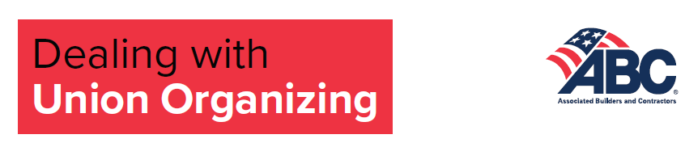
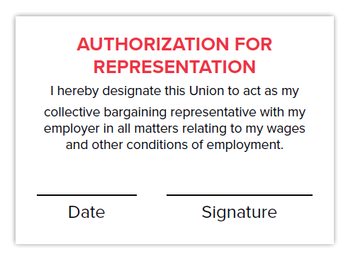
What You Should Be Doing Now To Prepare
Rapid Response Toolkit – Dealing with Union Organizing
  Card signing Do’s and Don’t’s
  Talking points – messaging to employees and customers
  NLRB basic election procedures
  Union “salting” in the workplace
  Protecting job sites – picketing checklist – “reserve gates”
Management training is key
Workplace self-audits to reduce exposure to lawsuits and worker complaints

Slide 11
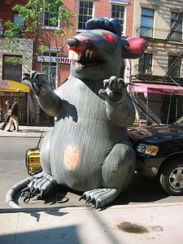
How Do Unions Organize?
Two organizing methods in the construction industry –
  Bottom up (card signing and voting by employees)
  Top down (pressure through government mandates; threatening your business by exposing law violations; bannering and picketing)
  Or combinations of both

Slide 12
More Changes Coming for Federal Government Contractors:
Traps Aimed at Merit Construction
Total rewrite of the Davis-Bacon regulations about to be issued by USDOL
  Federal construction contracts more likely to be union wage scales
  Union work assignments will more likely control the project
  More severe penalties for violations and more aggressive enforcement
  ABC preparing for legal challenge
Union PLA Executive Order from the President soon to go into effect
  All projects over $35M will be presumed to be union-only unless an exception is justified
  ABC preparing for legal challenge
OFCCP targeting construction, with new demands and enforcement threats
OSHA rules coming: union walkarounds, expanded electronic injury reporting

Slide 13
More Crazy Rules Coming from Federal Agencies
FTC proposing to eliminate most non-competes, defying 100 years of precedent
OSHA proposing to allow unions to “walk around” with inspectors in non-union workplaces.
Federal apprenticeship task force looking for new ways to favor union over non-union registered apprenticeship programs
New USDOL rules expected soon on Independent Contractors and Overtime Exemptions

Slide 14
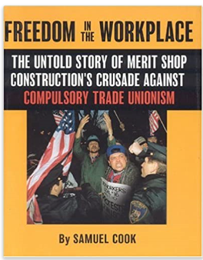
ABC Resources
www.abc.org
www.littler.com
mbaskin@littler.com
ABC’s Practical Labor Handbook (contact mbaskin@littler.com or Livingston@abc.org)
Construction Legal Rights Foundation (CLRF)

